Slide 1


Multi-omics Boot Camp
Analysis of Omics Data for Research Studies
Polygenic analysis and Summary statistics
Nick Mancuso
nmancuso@usc.edu
Zeyun Lu
zeyunlu@usc.edu

Slide 2
Goals
Understand GWAS, PRS, and summary-based integrative analyses
Understand statistical modeling of PRS and GWAS summary data
GWAS analysis
Integrating PRS as a risk factor
Integrating SNP-based predicted omic as a risk factor
Analyses with multiple PRS.
Apply the methods mentioned above in R and be able to interpret the results

Slide 3
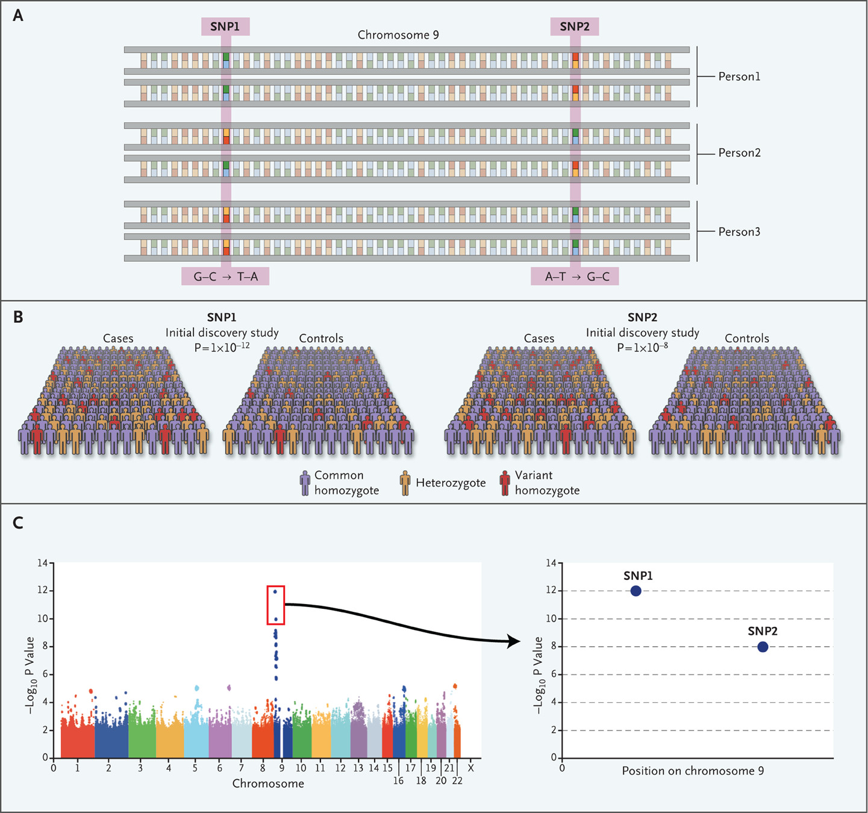
Genome-wide association studies
Quantify common genetic variation (SNPs)
Large cohorts and simple models
Test for association between SNP and disease
Manolio TA. N Engl J Med 2010

Slide 4
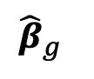
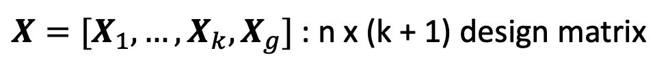
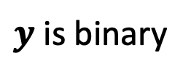
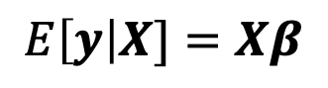
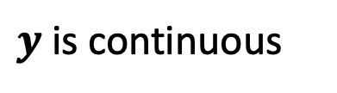
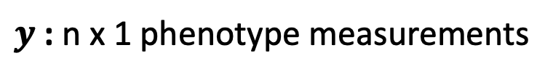
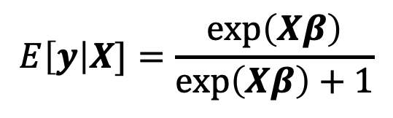
Genome-wide association studies
Simple models
$y$ : n x 1 phenotype measurements
$X=[X_{1}, …, X_{k}, X_{g}]$ : n x (k + 1) design matrix
$y$ is continuous
$y$ is binary
$$E\left[y\right|X]=\frac{exp\left(Xβ\right)}{exp\left(Xβ\right)+1}$$
$$E\left[y\right|X]=Xβ$$
$${\hat{β}}_{g}$$

Slide 5
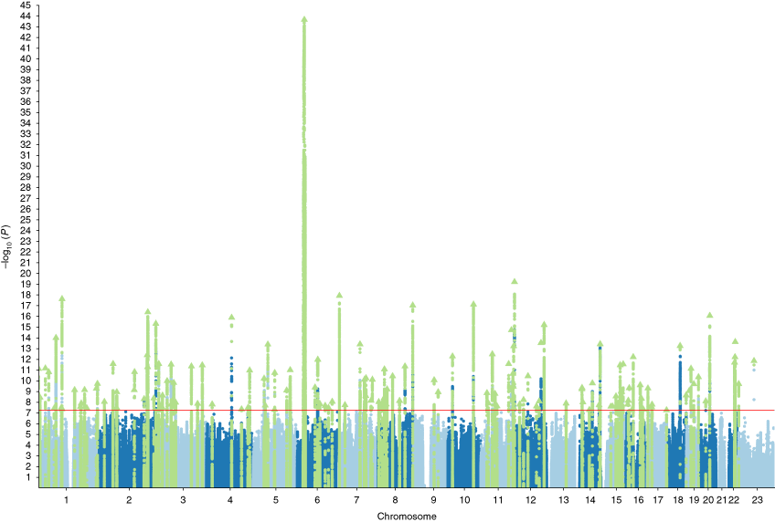
Genome-wide association studies
Common diseases are polygenic
100s to 1000s of causal variants underlie risk
Pardinas et al. Nat Gen 2018

Slide 6
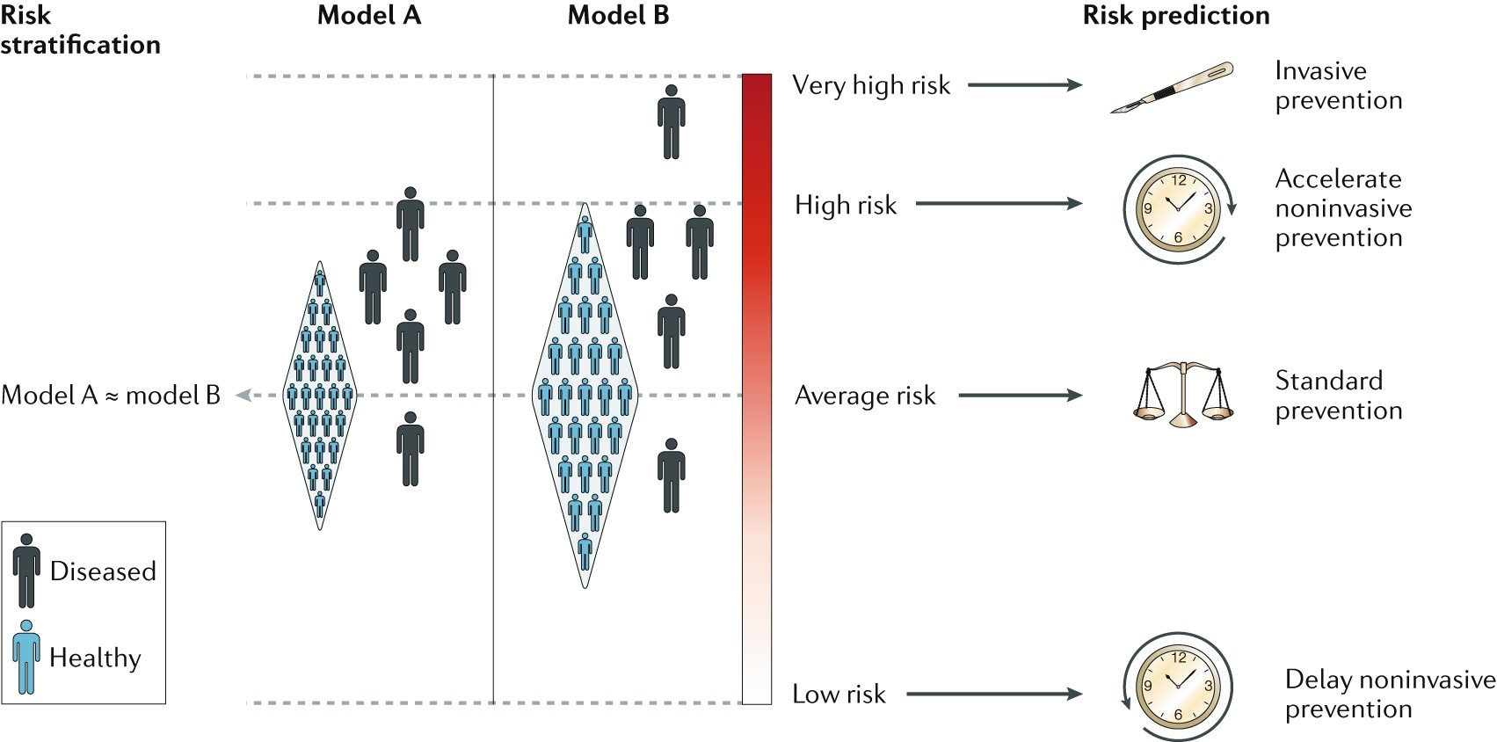
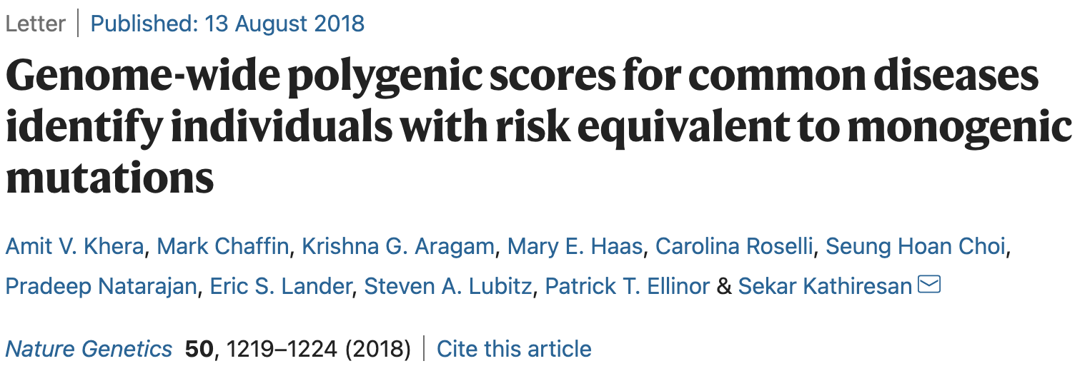
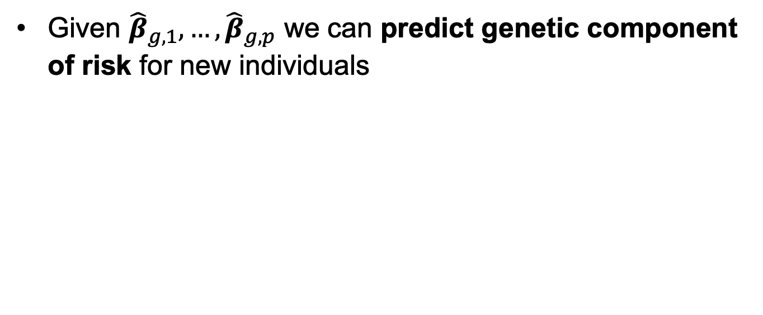
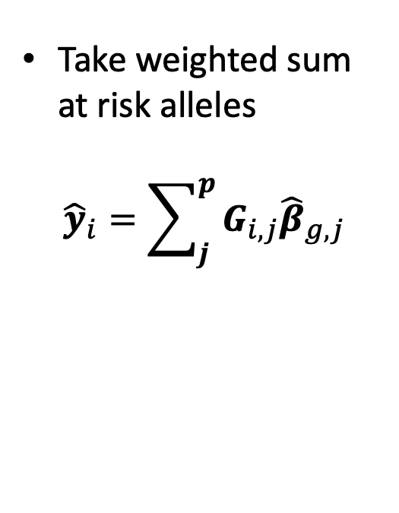
Polygenic Risk Prediction
Given ${\hat{β}}_{g,1}, …,{\hat{β}}_{g,p}$ we can predict genetic component of risk for new individuals
Take weighted sum at risk alleles
$${\hat{y}}_{i}=\sum_{j}^{p}{G_{i,j}{\hat{β}}_{g,j}}$$
Torkamani et al. Nat RevGen 2018

Slide 7
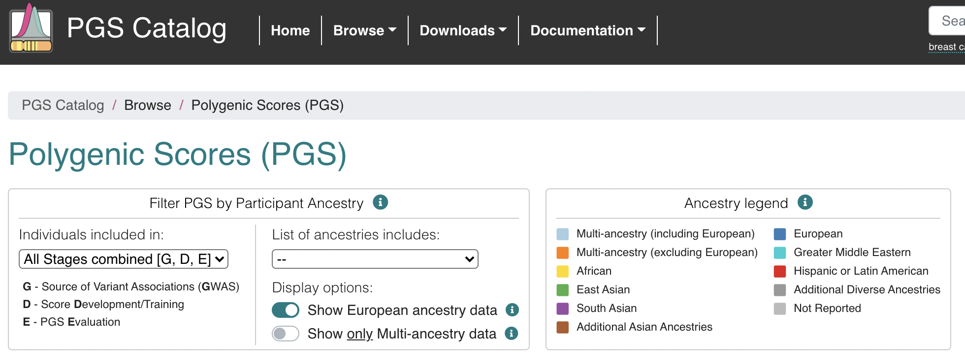
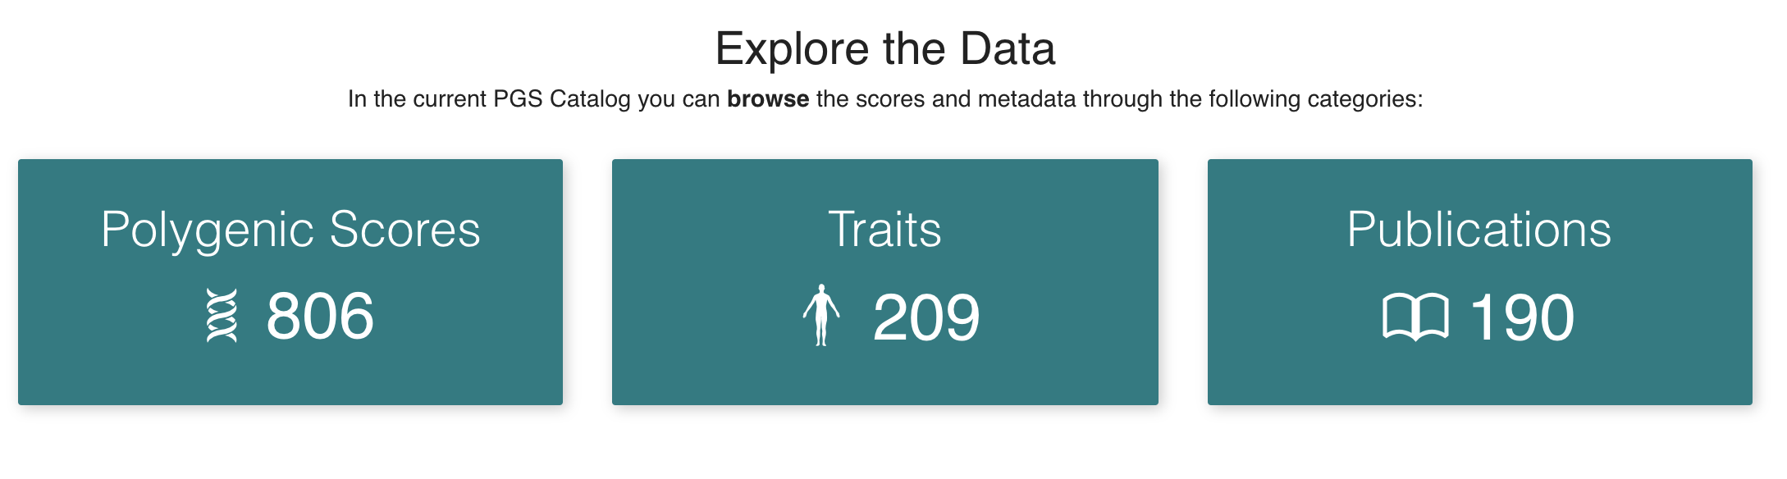
PRS Catalog
www.pgscatalog.org

Slide 8
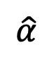
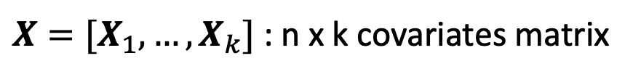
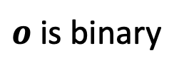
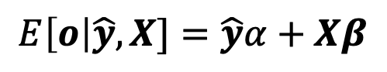
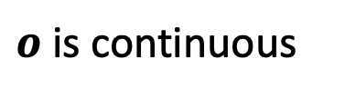
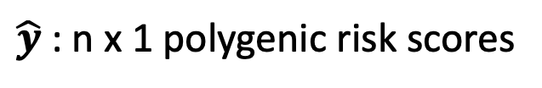
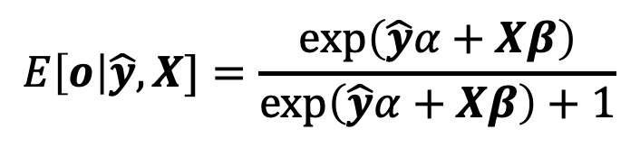
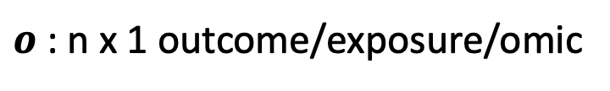
PRS utility in multi-omics
PRS as a risk factor for exposures/outcomes
$\hat{y}$ : n x 1 polygenic risk scores
$X=[X_{1}, …, X_{k}]$ : n x k covariates matrix
$o$ : n x 1 outcome/exposure/omic
$o$ is continuous
$o$ is binary
$$E\left[o\right|\hat{y},X]=\frac{exp\left(\hat{y}α+Xβ\right)}{exp\left(\hat{y}α+Xβ\right)+1}$$
$$E\left[o\right|\hat{y},X]=\hat{y}α+Xβ$$
$$\hat{α}$$

Slide 9
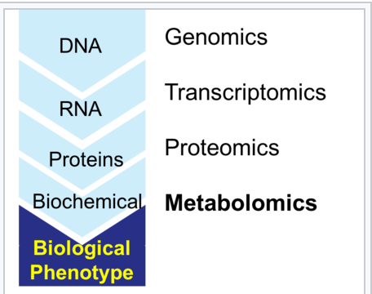
What is a phenotype?
Anything we can measure?
Anything we can measure by proxy?
Are we limited to PRS for “risk”?
https://en.wikipedia.org/wiki/Metabolomics

Slide 10
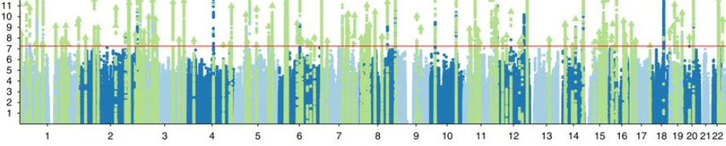
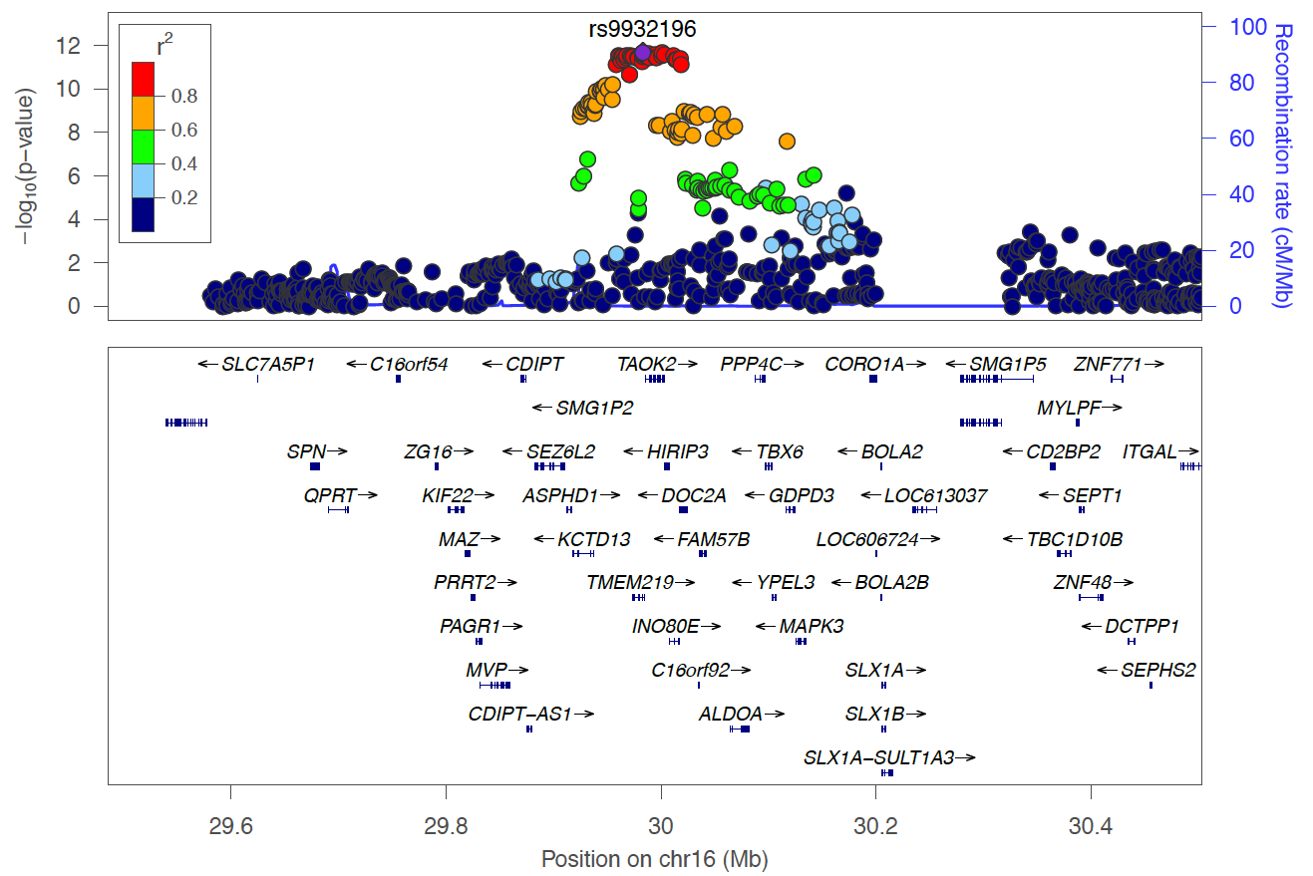
GWAS does not provide causal mechanisms
GWAS provides regions associated with disease risk
What are the mechanisms driving disease risk?
Most associations are non-coding
SNPs with regulatory function are strong candidates
Pardinas et al. Nat Gen 2018
Notes:
Explain figure;

Slide 11
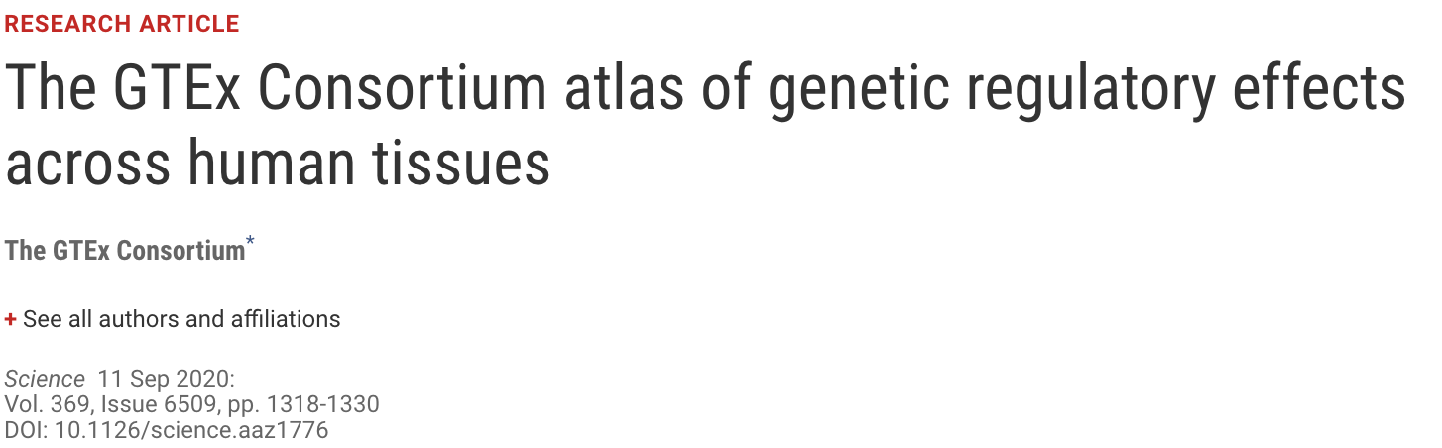
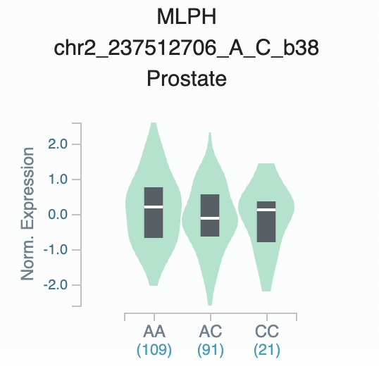
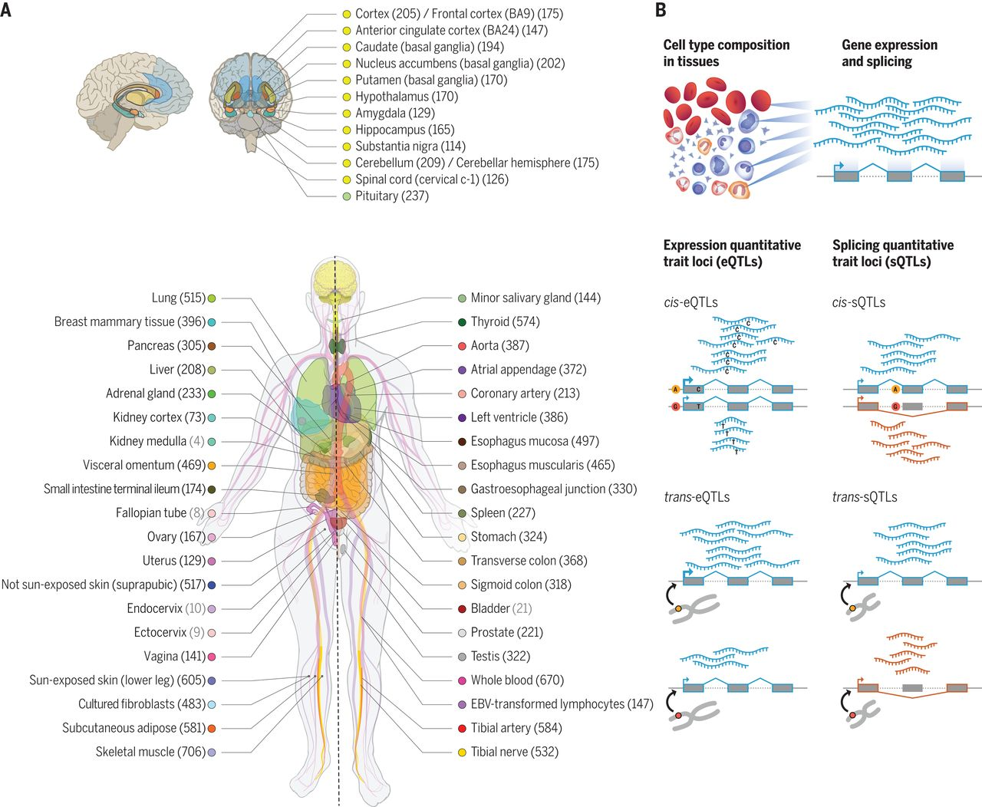
Insights from expression QTL scans
www.gtexportal.org
GTEx Consortium - Science, 2020

Slide 12
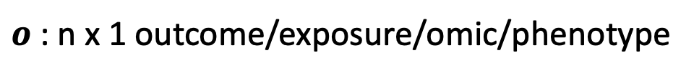
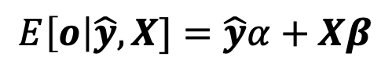
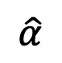
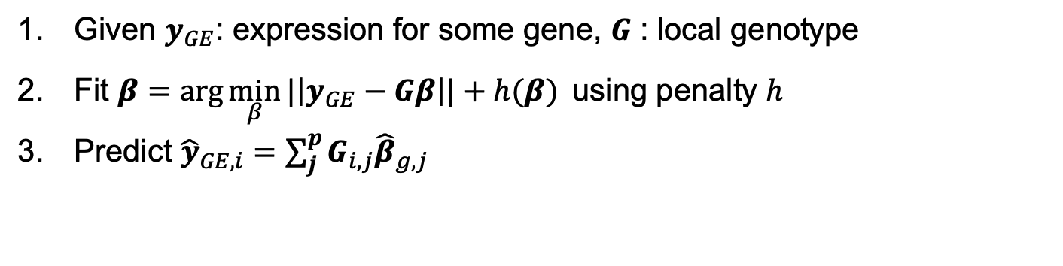
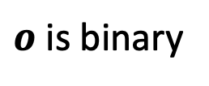
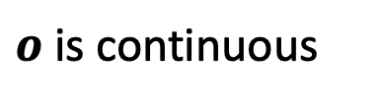
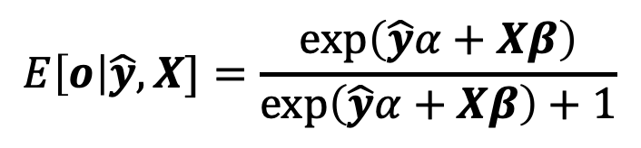
Transcriptome wide association study
Given $y_{GE}$: expression for some gene, $G$ : local genotype
Fit $β=\arg{\min_{β}{|\left|y_{GE}−Gβ\right||}}+h(β)$ using penalty $h$
Predict ${\hat{y}}_{GE,i}=\sum_{j}^{p}{G_{i,j}{\hat{β}}_{g,j}}$
$o$ : n x 1 outcome/exposure/omic/phenotype
$o$ is continuous
$o$ is binary
$$E\left[o\right|\hat{y},X]=\frac{exp\left(\hat{y}α+Xβ\right)}{exp\left(\hat{y}α+Xβ\right)+1}$$
$$E\left[o\right|\hat{y},X]=\hat{y}α+Xβ$$
$$\hat{α}$$
Gamazon et al. Nat Gen 2015; Gusev et al. Nat Gen 2016

Slide 13

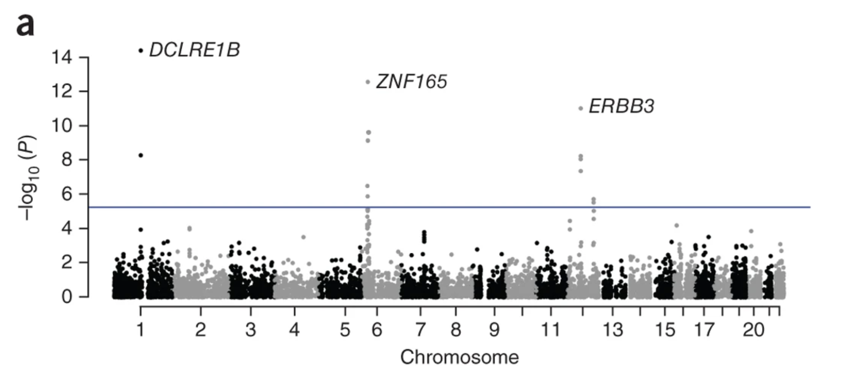
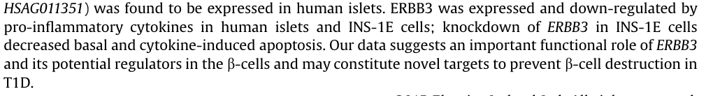
TWAS identifies T1D susceptibility genes
WTCCC ~ 2k / 3k cs/ctl
Gamazon et al. Nat Gen 2015

Slide 14
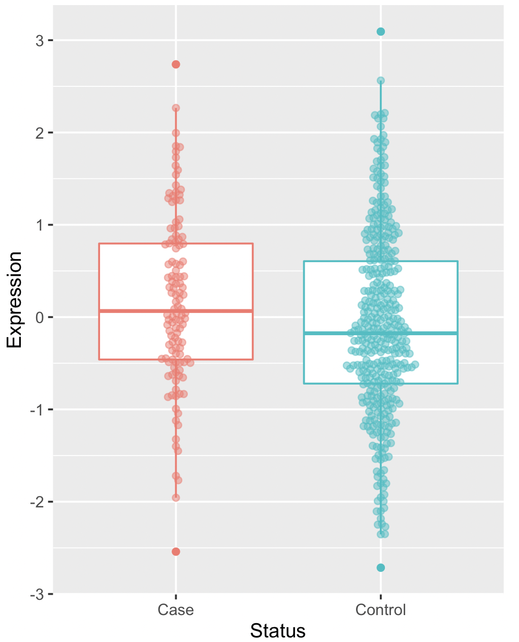
Validation Scenario
Identify gene/trait or gene/disease association using multi-omics panel
Collect more data and validate in-sample
Fit SNP-based predictor for gene in-sample and predict into external GWAS
Validation Options:
GWAS data is restricted due to privacy + logistics

Slide 15
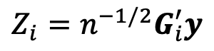
GWAS summary data describe magnitude and direction of SNP→trait
SNP A1 A0 BETA SE GWAS.Z
rs587702478 T C 0.34 0.16 2.11
rs367963583 T G 1.46 1.73 0.85
rs62224609 T C 0.01 0.02 0.27
rs62224611 A C 0.01 0.02 0.27
rs4965031 A G 0.01 0.02 0.27
Effect (log-odds)
Standard error of the estimate
Z-score (Wald Statistic)
Z-score is a linear combination of phenotype (y) and genotype (G)
$$Z_{i}=n^{−1/2}G_{i}^{′}y$$

Slide 16
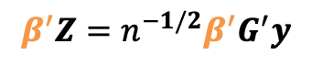
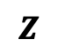
TWAS using GWAS summary data
We predict into GWAS using summary data
Marginal Z score reflect marginal geno/trait association
Weighted sum of Z score reflects weighted sum of geno/trait association
SNP-trait
standardized
effects
Imputed
Gene-Trait
effect
$$β^{′}Z=n^{−1/2}β^{′}G^{′}y$$
$$Z$$
1
5
2
1
2
7
β₁
β₂
β₃
β₄
β₅
SNP LD
reference
Gusev et al. Nat Gen 2016

Slide 17
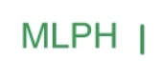
MLPH underlies PCa risk
www.gtexportal.org
Schumacher et al. Nat Genet 2018; Grisanzio PNAS 2012; Li HuMolGen 2014; Al Olama NatGen 2014; Huang NatGen 2014; Xu EurJHumGenet 2014; Penney Cancer Epi&Biomarkers 2015; Thibodeau NatComm 2015; Whitington NatGen 2016
Mancuso et al. Nat Comms 2018

Slide 18


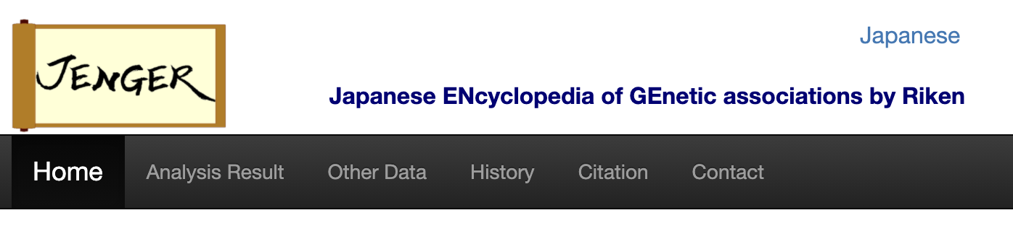
Biobank-scale GWAS summary data
https://pan.ukbb.broadinstitute.org/
http://www.nealelab.is/uk-biobank
http://jenger.riken.jp/en/

Slide 19
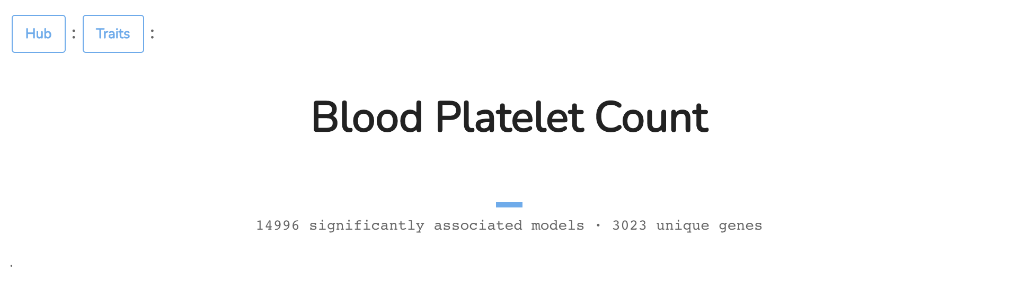
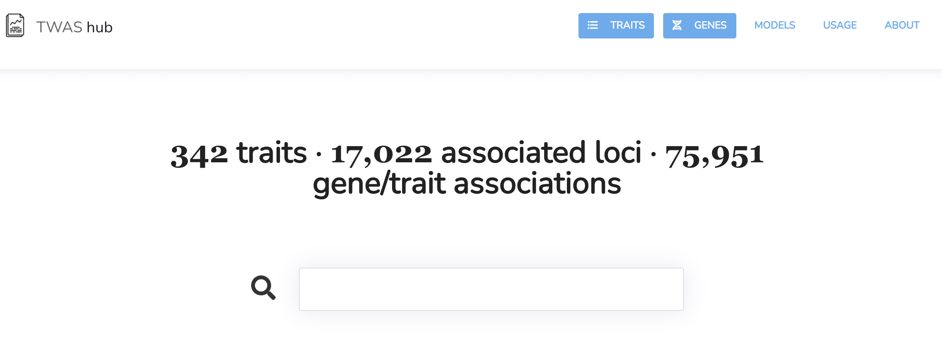
TWAS Hub
http://twas-hub.org/

Slide 20
What is a phenotype?
Anything we can measure?
Anything we can measure by proxy?
Are we limited to PRS for “risk”?
https://en.wikipedia.org/wiki/Metabolomics

Slide 21
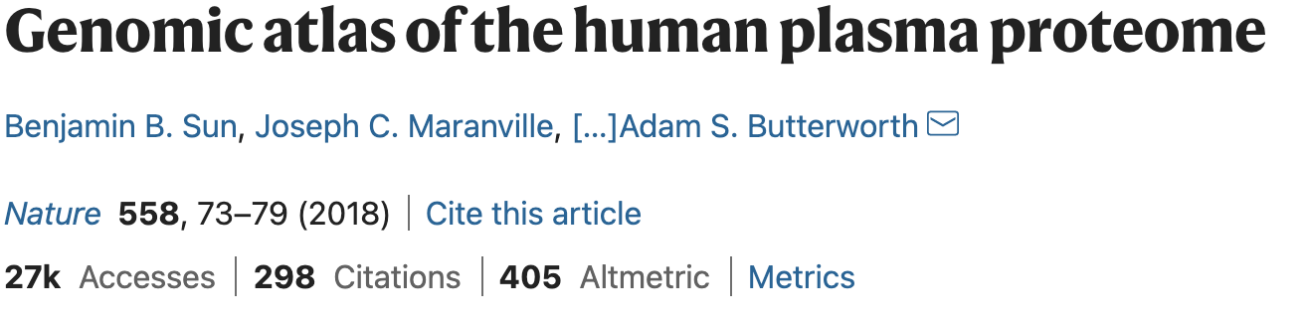
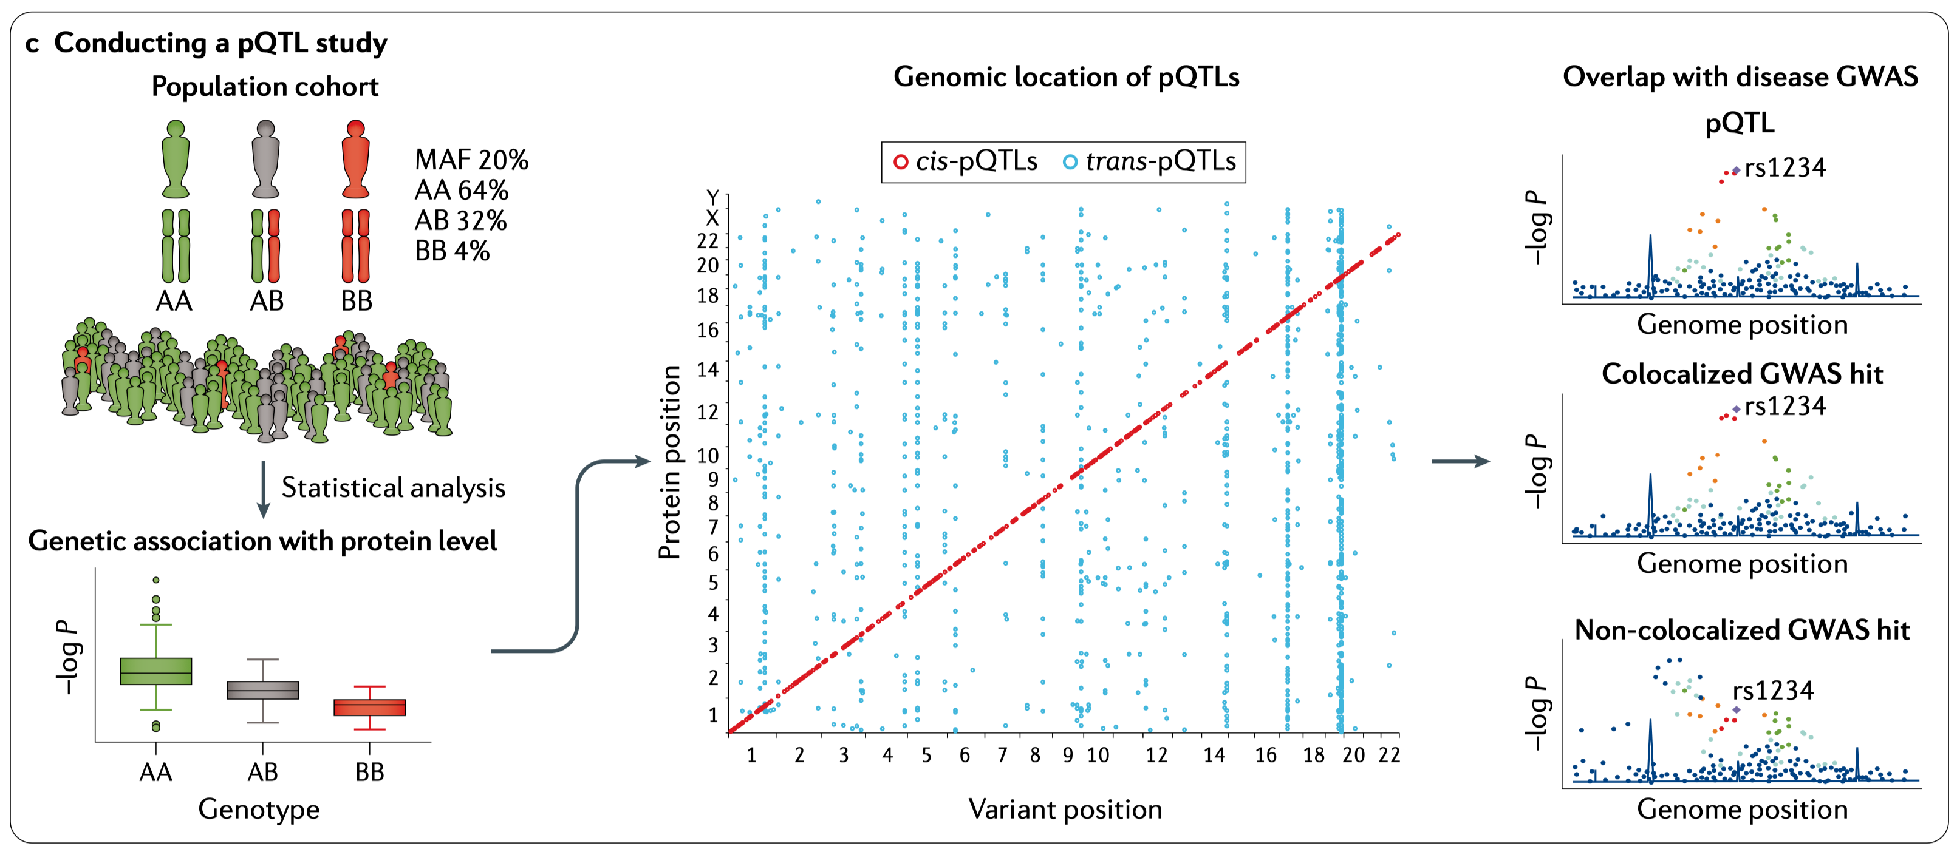
Insights from protein QTL scans
Sun et al. Nature 2018

Slide 22
What is a phenotype?
Anything we can measure?
Anything we can measure by proxy?
Are we limited to PRS for “risk”?
https://en.wikipedia.org/wiki/Metabolomics

Slide 23
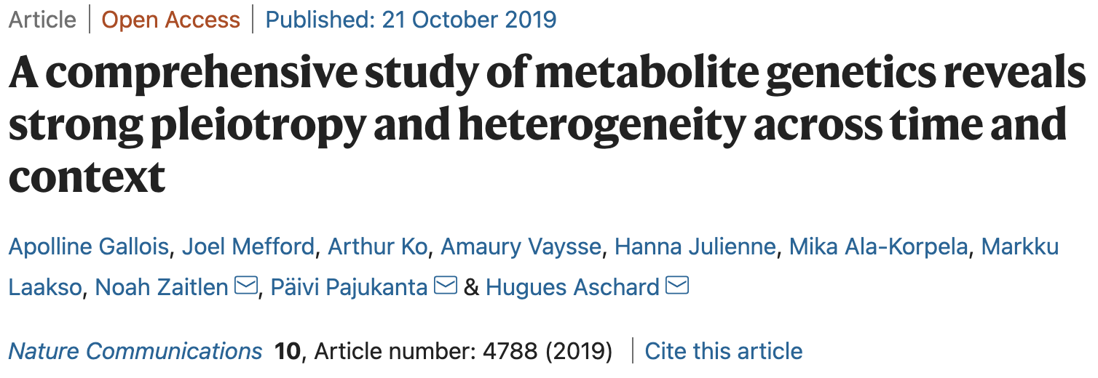
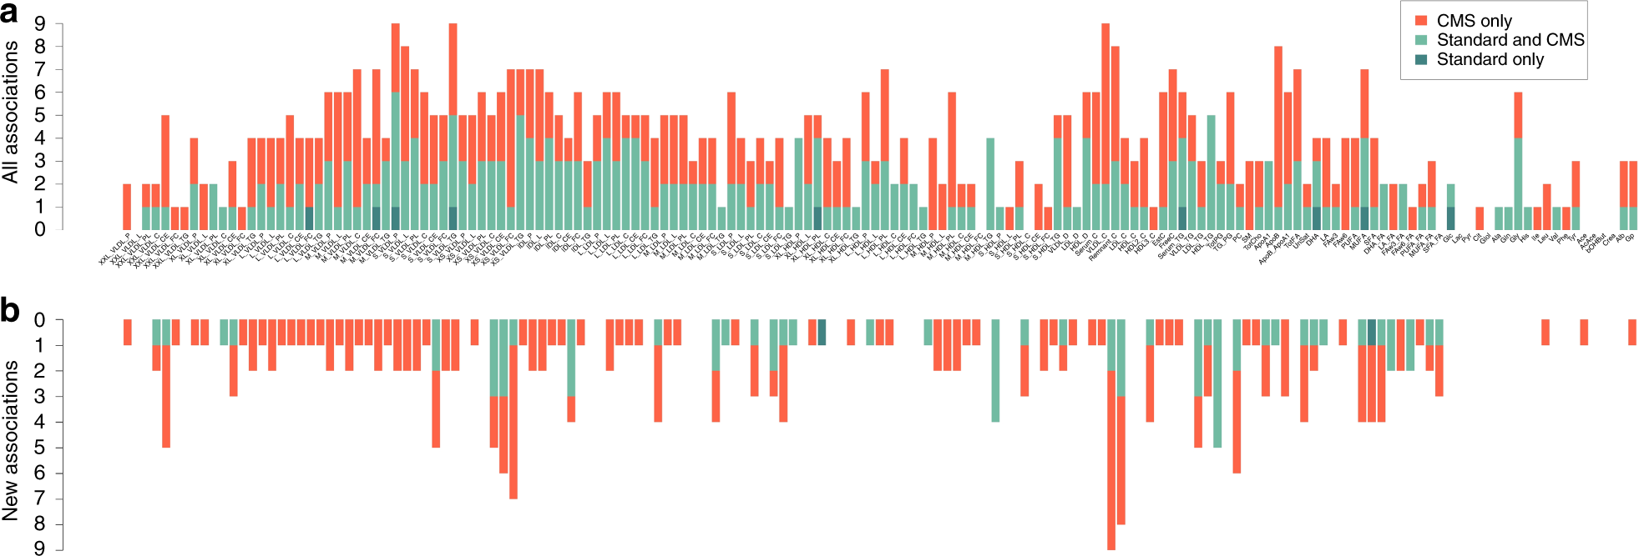
Insights from metabolite GWAS

Slide 24

Conceptual framework for summary-based association testing
Question: Does omic-feature influence disease risk?
GWS effect-sizes
${\hat{β}}_{x}={\hat{β}}_{x,1}, …,{\hat{β}}_{x,p}$ in omic-feature of interest
${\hat{β}}_{y}={\hat{β}}_{y,1}, …,{\hat{β}}_{y,p}$ in disease of interest
$s_{y,1}^{2}, …,s_{y,p}^{2}$ (standard errors for disease beta)

Slide 25


Conceptual framework for summary-based association testing
Impose linear model
${\hat{β}}_{y}$= ${\hat{β}}_{x}α+ε$, where $ε_{j}∼N(0,s_{y,j}^{2}$)
Can solve for $\hat{α}$ using weighted least squares
Caveats:
${\hat{β}}_{x}$ should predict the omic with “reasonable” accuracy
${\hat{β}}_{x}$ must have variation, otherwise cannot estimate $\hat{α}$

Slide 26


Mendelian Randomization
Katan MB. Lancet 1986; Grey, Wheatley, Bone Marrow Transplantation 1991;

Slide 27









Mendelian Randomization
$G$ genetic variant
$U$ confounding
$X$ exposure
$Y$ outcome
$$β_{y}=β_{x}α$$
$$β_{x}$$
$$α$$
$Y$GWAS
$X$GWAS
${\hat{β}}_{y}$= ${\hat{β}}_{x}α+ε$
$ε_{j}∼N(0,s_{y,j}^{2}$)
Davey Smith, et al International Journal of Epidemiology 2003.
Bowden et al. International Journal of Epidemiology 2013

Slide 28

MR Base
http://app.mrbase.org/

Slide 29
Mendelian Randomization
$G$ genetic variant
$U$ confounding
$X$ exposure
$Y$ outcome
$$β_{y}=β_{x}α$$
$$β_{x}$$
$$α$$
$Y$GWAS
$X$GWAS
?
${\hat{β}}_{y}$= ${\hat{β}}_{x}α+ε$
$ε_{j}∼N(0,s_{y,j}^{2}$)
Davey Smith, et al International Journal of Epidemiology 2003.
Bowden et al. International Journal of Epidemiology 2013

Slide 30


Multi-variate MR
Impose linear model
${\hat{β}}_{y}$= $\sum_{k}^{K}{{\hat{β}}_{x,k}α_{k}+ε}$, where $ε_{j}∼N(0,s_{y,j}^{2}$)
or in matrix notation,
${\hat{β}}_{y}$= $\hat{B}α+ε$ , where $\hat{B}=[{\hat{β}}_{x,1}, …,{\hat{β}}_{x,K}]$
Can solve for $\hat{α}$using weighted least squares
Burgess, et al. American Journal of Epidemiology 2015;
Jiang, …, Mancuso, …, Conti. American Journal of Epidemiology. 2020.

Slide 31


Caveats of SNP-based prediction

Slide 32


Caveats of SNP-based prediction
eLife

Slide 33


Diverse GWAS cohorts improves PRS portability

Slide 34
Questions?
Thank you! Short break, and then lab!

